Slide 1



Scanning…
What Fell Under the Radar? Accountability and the NYPD
Shantell Richardson
Christian Rios-Chambi
Jing Wu

Slide 2
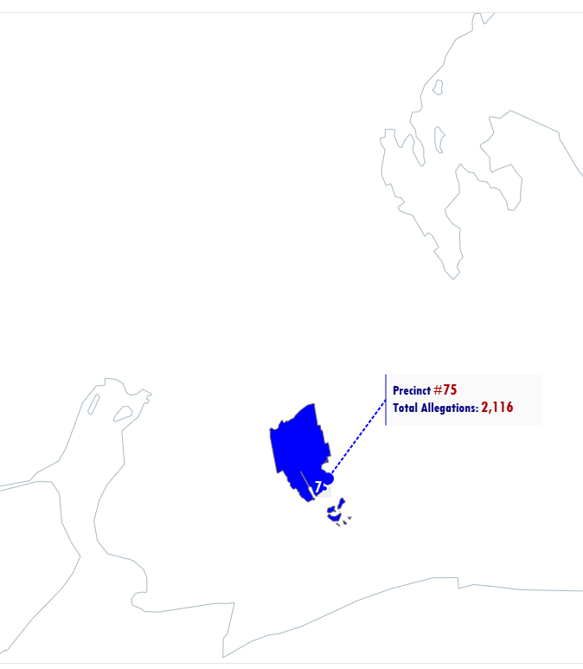
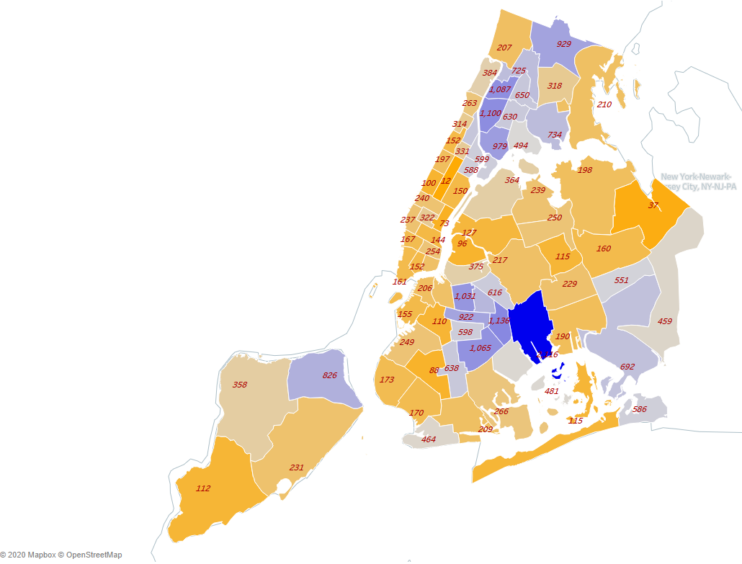
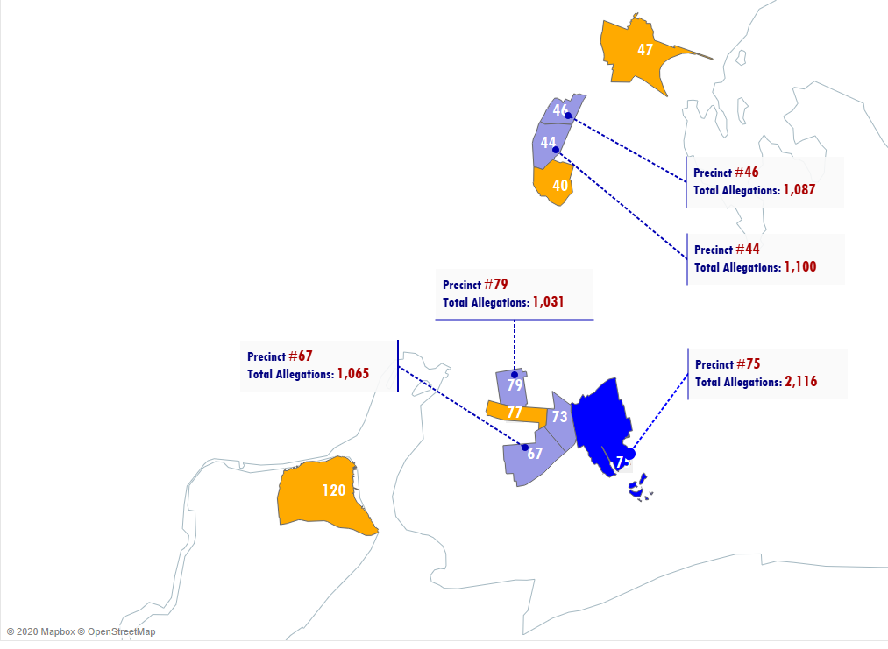
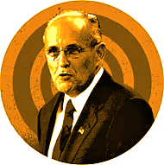



The Giuliani Era
Precinct #75 accounts for 4.5% of all allegations from 1994 to 2003
Total Allegations by Precinct
The Bloomberg Era
Precinct #75 accounts for 7.3% of all allegations from 2004 - 2013
The DeBlasio Era
Precinct #75 accounts for 5.9% of all allegations from 2014 to 2020

Slide 3
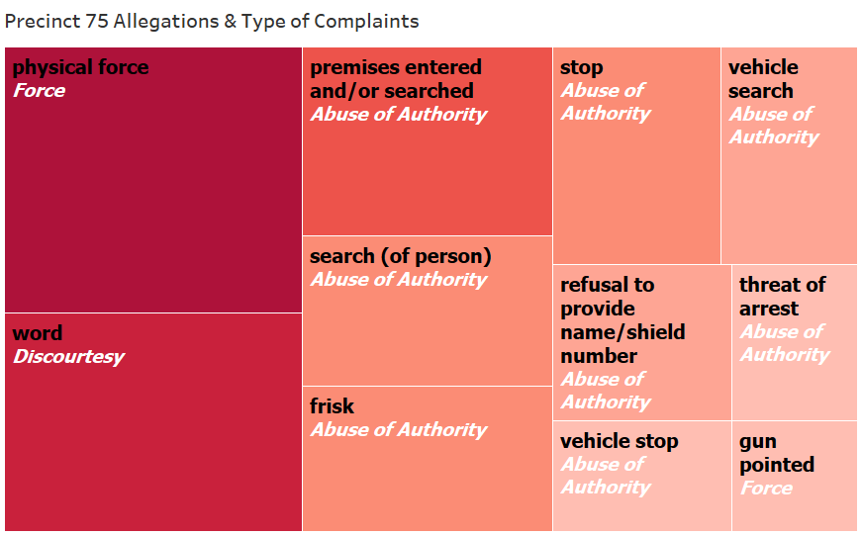
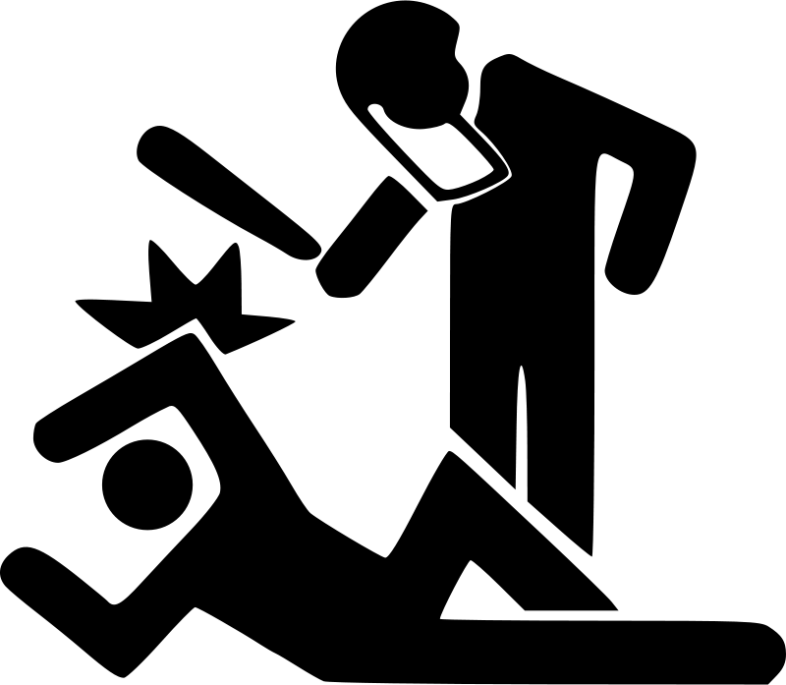


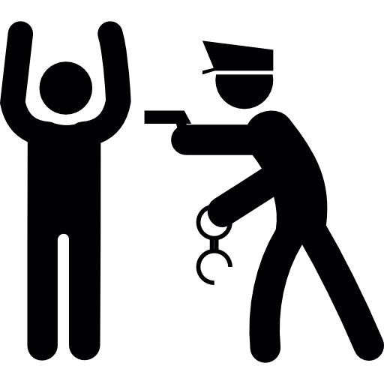
Top Allegations Against Precinct 75
Allegation (black) =
Specific type of complaints
Fado Type (white) =
Umbrella category of complaints
Notes:
Found top allegations were physical force, word, searches(either person or vehicle), there was even consistently allegations that precinct 75 pointed their weapons.
The most common umbrella type of allegation was abuse of authority
Since 75 had highest numbers of allegations against them spanning from 1994-2020, were they being held accountable? What was going on? TRANSITION TO CHRISTIAN

Slide 4
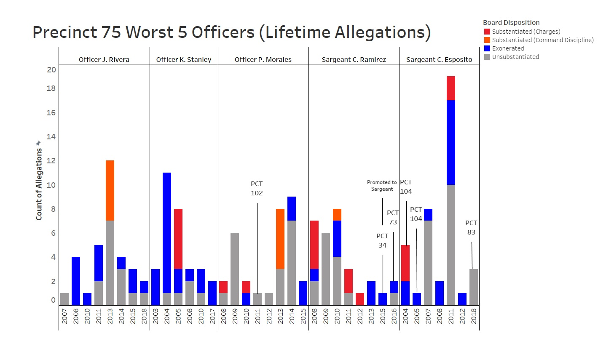
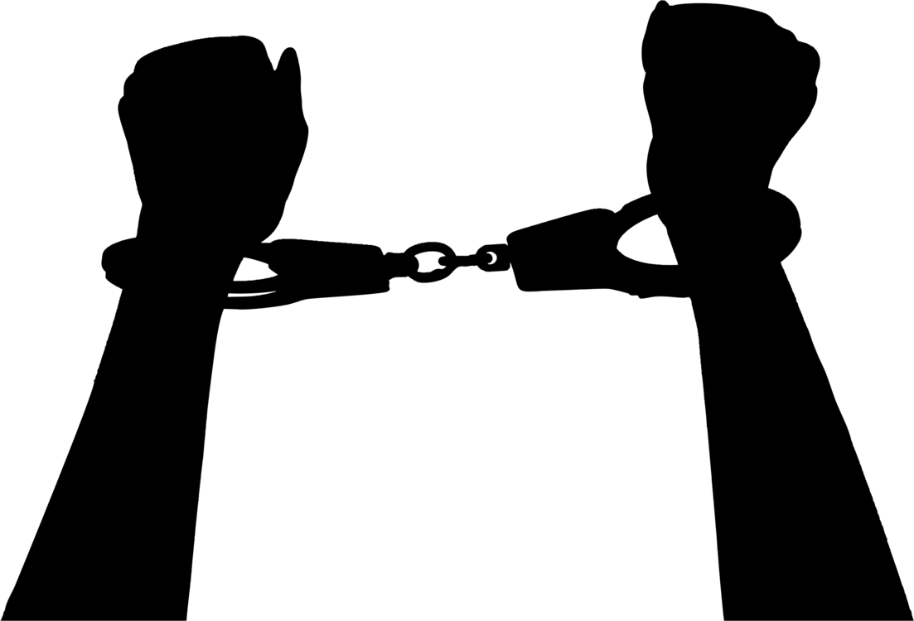
The PCT # annotation shows whenever a officer received an allegation outside of Precinct 75

